Slide 1

Make your Drive Digital
FA22-FYP-06

Slide 2

BACKGROUND
Basically we are working on a mechatronics project which will provide the user their management of hard drive data at any time and any place without the use of computer, now they can see the data of hard drive visually without the normal computers and laptops they use on their daily life, so now they can securely transfer data, can view, delete or move the data without computers.

Slide 3
PROBLEM STATEMENT
The process to manage data of hard drives requires a PC or laptop which is not portable, also for the data securing it is not that secure, Moreover connecting hard drives to your computer can infect you computer with malwares too, and to view data of a hard drive you always require a medium for which we use PC or laptop that’s basically is neither always available nor portable.
Hard Drives

Slide 4
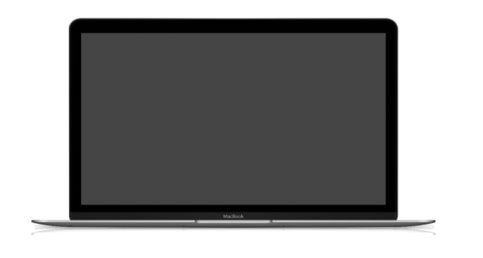
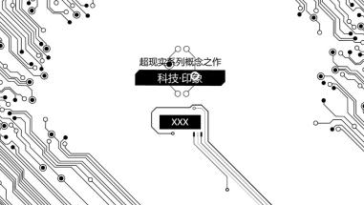
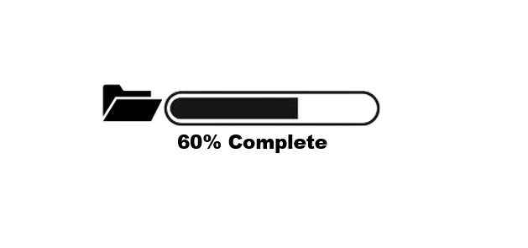
CURRENT SOLUTION
The current solution of this problem is laptop because it is consider as the most portable device for every work

Slide 5

PROPOSED SOLUTION
Now as we know the problem, the proposed solution is a digital hard drive which can work with a small micro computer, display your data in a screen can transfer or move the data in a secure environment and which will be a more portable device

Slide 6
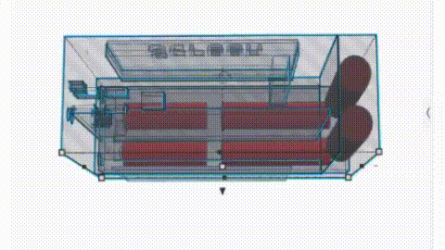
HARDWARE COMPONENTS
A raspberry pi microcomputer
Battery to provide power supply
A mini 5 inches touch screen
A Micro SD card for OS
A SSD
Other Small Components

Slide 7
METHODOLOGY
ITERATIVE
1
st step
Planning
2
nd step
Analysis
3
rd step
Implementation
4
th step
Evaluation

Slide 8
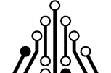
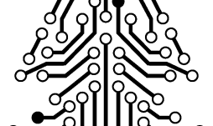
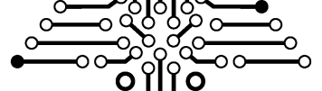
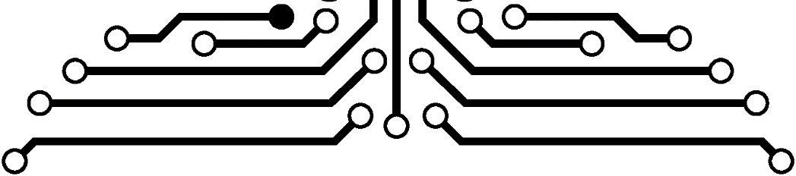
MAIN FEATURES
4 features
Portable device
Secure environment
Safe transferring
Viewable data

Slide 9





COMPITITORS
Portable hard drives manufacturer

Slide 10
POTENTIAL USERS
Traveler (Videographer/Photographer)
Organization
(Having sensitive data)
Shopkeepers
(Hard-Drive repairer/sellers)
USERS

Slide 11
Thank You

